Slide 1
More on R²

Slide 2


Interpreting r² : Explained Variation
The metric r² is called the coefficient of determination.
Key Point: The value of r² is the proportion of the variation in y that is explained by the linear relationship between x and y.
In ANOVA, $r^{2}=\frac{{SS}_{model} (top row)}{{SS}_{total} (bottom row)}$
Notes:
page 524 of text
If using a graphics calculator for demonstration, it will be an easy exercise to switch the x and y values to show that the value of r will not change.

Slide 3
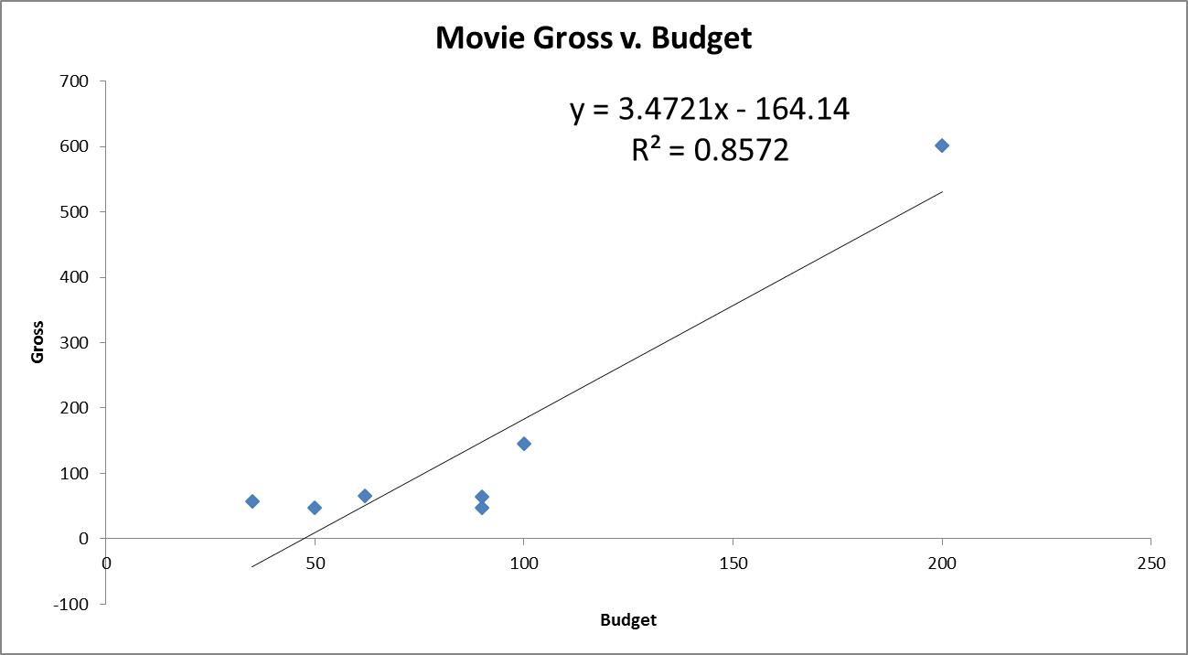

r and r²: Not resistant to outliers
$ρ$ is the population correlation that $r$ estimates.

Slide 4
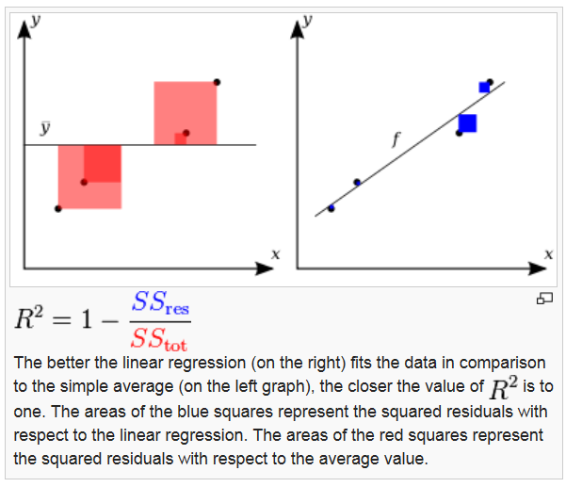
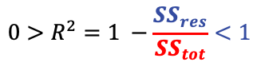
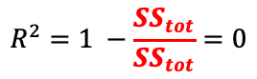
R²: comparing SS(straight line model) to SS(equal means model)
$$R^{2}=1 −\frac{SS_{tot}}{SS_{tot}}=0$$
$${0>R}^{2}=1 −\frac{SS_{res}}{SS_{tot}}<1$$

Slide 5
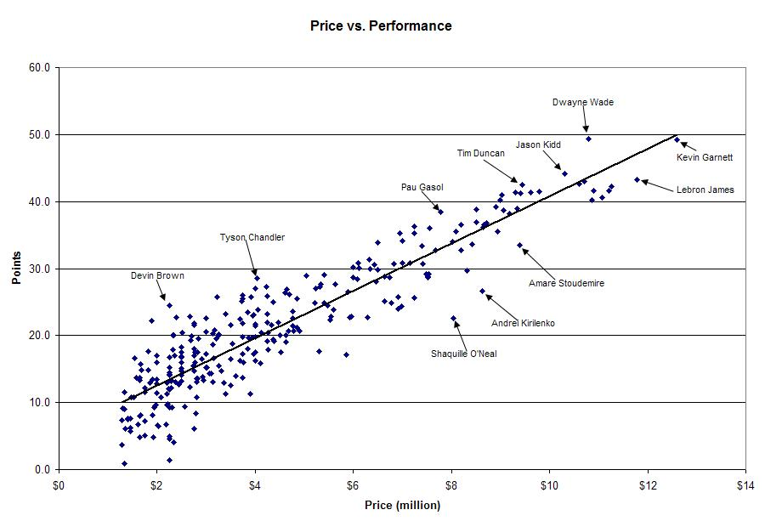
Do not confuse fewer data points with a smaller standard deviation.
r = .907
r² = 0. 823
It is estimated that price explains 82.3% of the variation in point production for NBA players in this year.

Slide 7
Example
Six-Step Hypothesis Test Full Analysis

Slide 8
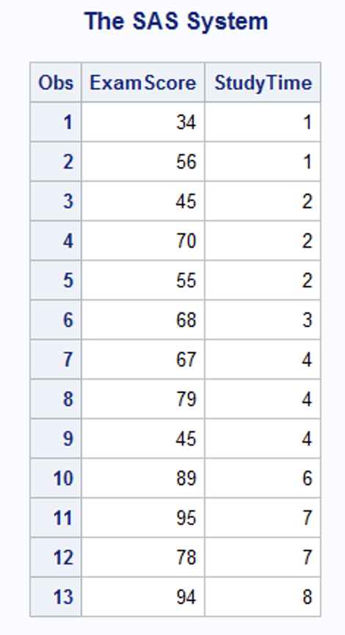
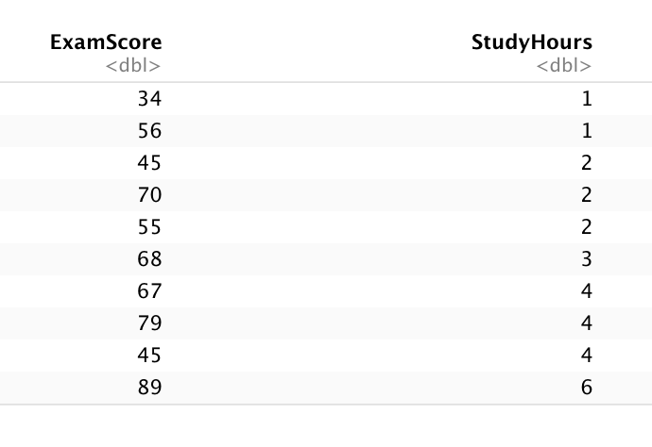
Exam Scores vs. Study Hours, Part I
data StudyTime;
input ExamScore StudyTime;
datalines;
34 1
56 1
45 2
70 2
55 2
68 3
67 4
79 4
45 4
89 6
95 7
78 7
94 8
;
proc print data = StudyTime;
run;
StudyTime = data.frame(ExamScore = c(34,56,45,70,55,68,67,79,45,89,95,78,94), StudyHours = c(1,1,2,2,2,3,4,4,4,6,7,7,8))
StudyTime

Slide 9
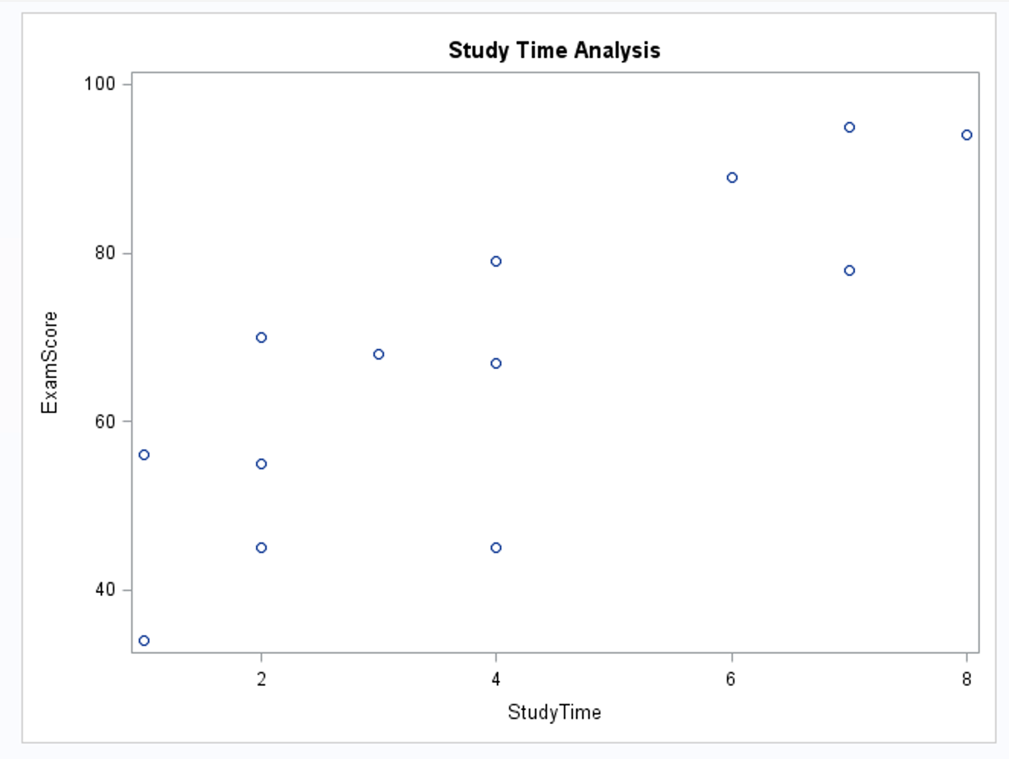
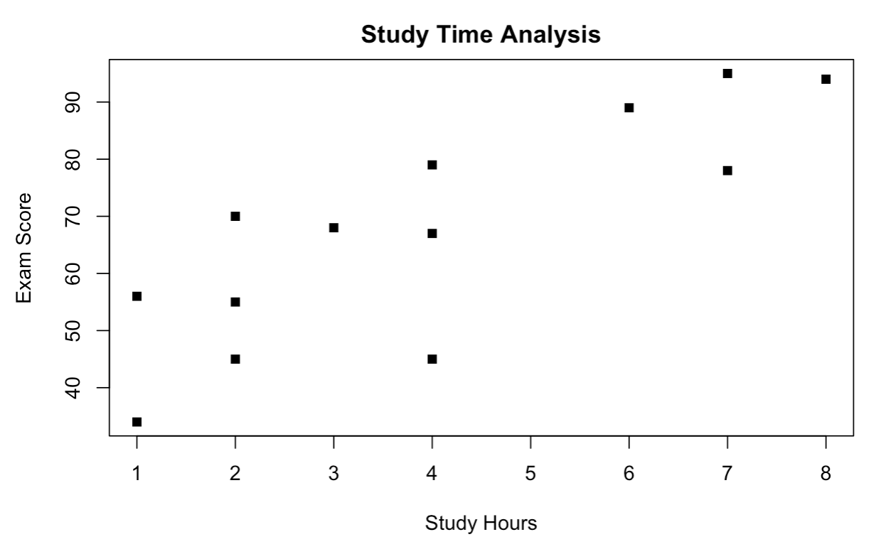
Exam Scores vs. Study Hours, Part II
Check the scatter plot to determine if a linear relationship is plausible.
proc sgscatter data = StudyTime;
plot ExamScore*StudyTime;
title "Study Time Analysis";
run;
plot(StudyTime$StudyHours,StudyTime$ExamScore, xlab = "Study Hours", ylab = "Exam Score", main = "Study Time Analysis",pch = 15)

Slide 10
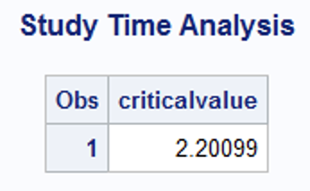
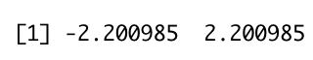
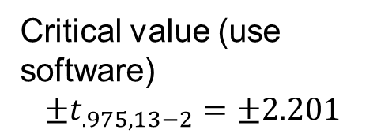
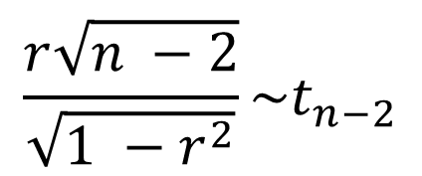
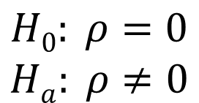
Exam Scores vs. Study Hours, Part III
$$H0: ρ=0$$
$$Ha: ρ≠0$$
$$\frac{r\sqrt{n −2}}{\sqrt{1 −r^{2}}}\sim t_{n−2}$$
Critical value (use software)
$$±t_{.975, 13−2}=±2.201$$
data mydata;
criticalvalue = quantile('t',.975, 13-2);
run;
proc print data = mydata;
run;
qt(c(.025,.975),11)
Test statistic?

Slide 11
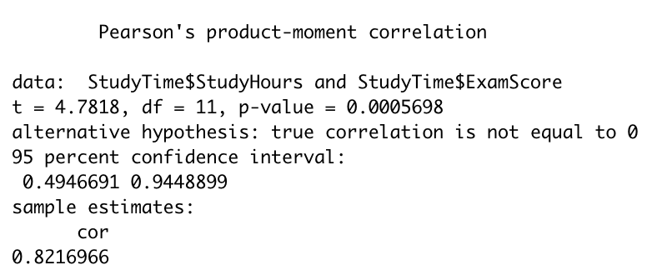
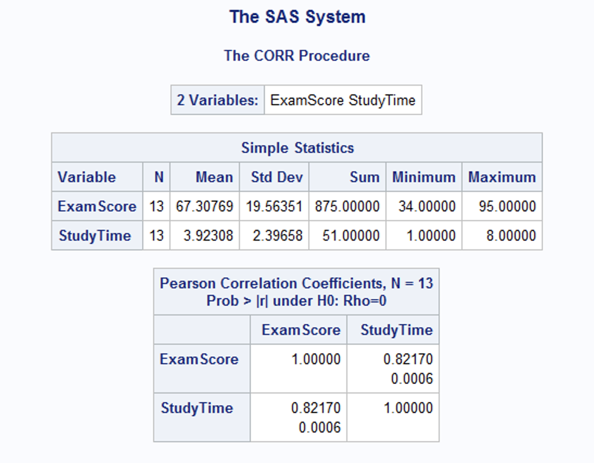
Exam Scores vs. Study Hours: Test Statistic, Part I
proc corr data = StudyTime;
run;
cor.test(StudyTime$StudyHours,StudyTime$ExamScore)
Sample correlation coefficient r

Slide 12
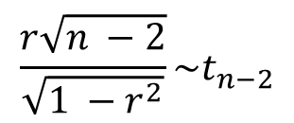
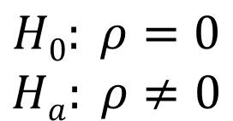
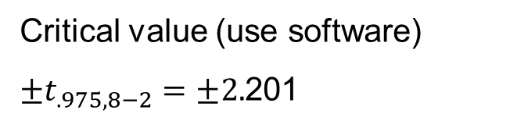
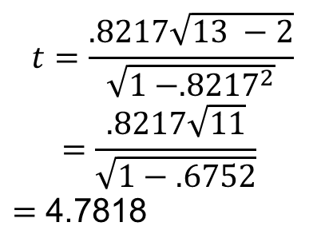
Exam Scores vs. Study Hours: Test Statistic, Part II
$$H0: ρ=0$$
$$Ha: ρ≠0$$
$$\frac{r\sqrt{n −2}}{\sqrt{1 −r^{2}}}\sim t_{n−2}$$
Critical value (use software)
$±t_{.975, 8−2}=±2.$201
Test statistic
$$t=\frac{.8217\sqrt{13 −2}}{\sqrt{1 −{.8217}^{2}}}$$
$$=\frac{.8217\sqrt{11}}{\sqrt{1−.6752}}$$
$=$ 4.7818
p-Value = ?

Slide 13
Exam Scores vs. Study Hours: Test Statistic, Part III
$$H0: ρ=0$$
$$Ha: ρ≠0$$
$$\frac{r\sqrt{n −2}}{\sqrt{1 −r^{2}}}\sim t_{n−2}$$
There is strong evidence at the alpha = .05 level of significance to suggest that exam scores are linearly related to study hours (p-value = .0006).
Critical value (use software)
$±t_{.975, 8−2}=±2.$201
It is estimated that r² = 67.52% of the variation in the exam score is explained by its relationship with study hours.
Test statistic
$$t=\frac{.8217\sqrt{13 −2}}{\sqrt{1 −{.8217}^{2}}}$$
$$=\frac{.8217\sqrt{11}}{\sqrt{1−.6752}}$$
$=$ 4.7818
Because we do not know much about how the data was selected (at least within the scope of this PowerPoint), we cannot generalize the results beyond the data under study, though the results are interesting. Because the study hours were not randomly assigned to the students, causality cannot be established, only association.
p-Value = .0006
Reject H₀ (at level alpha = 0.05)

Slide 15
Example
Study Hours “Least Squares” Line

Slide 16
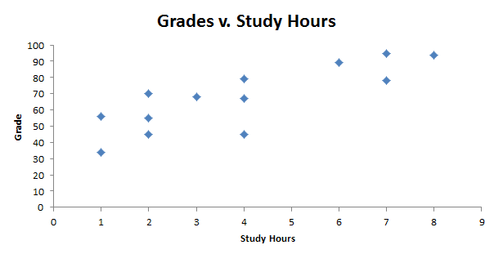
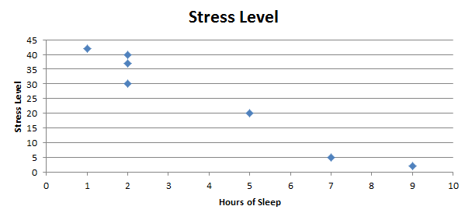

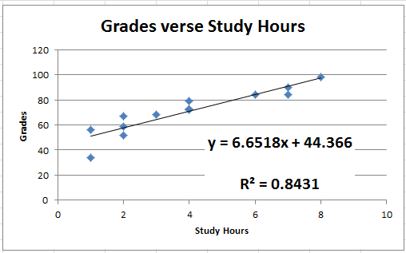
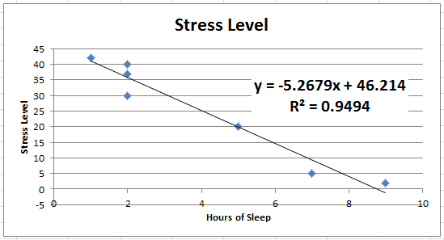
Grades vs. Study Hours
A
B

Slide 17
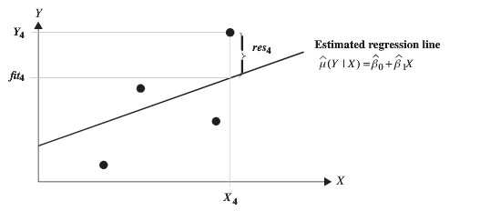
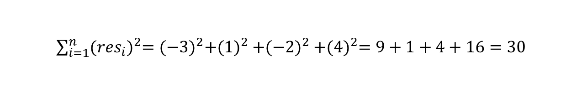
How to Find the “Best” Line
Residuals: res = observed − predicted
res₄ = 4
res₂ = 1
res₃ = -2
res₁ = -3
Notice if we simply add the residuals we will get zero!
This is why we will square each residual and then sum them together.
Sum of squared residuals = SSR =

Slide 18
Grades vs. Study Hours
res₉ = 0
res₁₂ = 5
res₁₃= 1
res₈ = 6
res₁₀ = 5
res₆ = 60
res₁₁ = -5
res₁₀ = 40
res₃ = 9
res₄ = 0
res₆ = 4
res₈ = 55
res₉ = 35
res₁ = 4
res₅ = -6
res₇ = -12
res₁₃ = 30
res₃ = 80
res₂= -11
res₇ = 20
res₁ = 50
res₅ = 60
The squared and summed green residuals will be greater than the squared and summed red residuals.
res₄ = 20
res₂ = 30

Slide 19
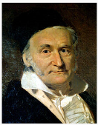
Least Squares Regression Line
The least squares line minimizes the sum of squared residuals!

Slide 21
Prediction

Slide 22
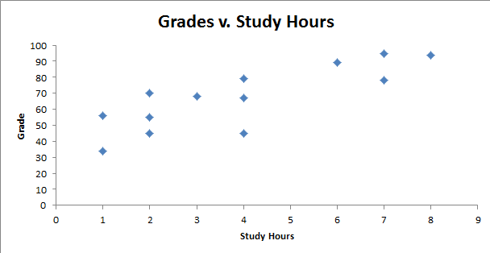
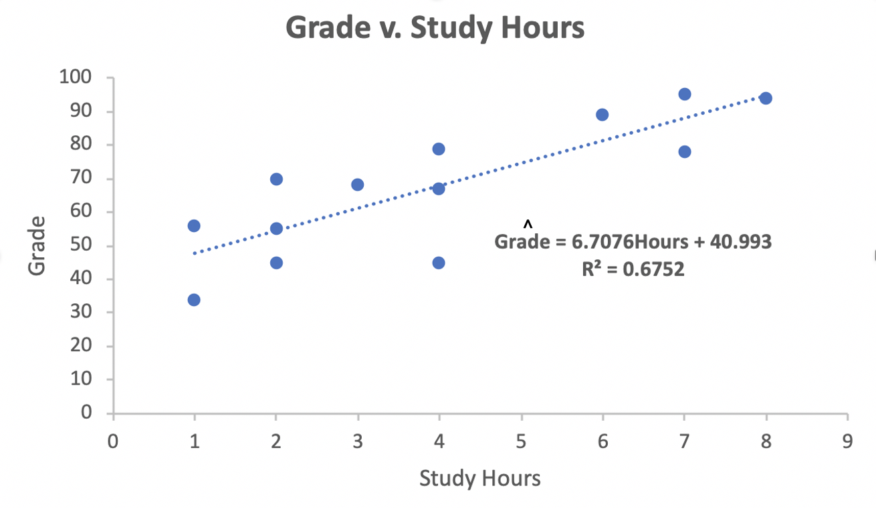
Grades vs. Study Hours
We can use the regression line to predict a grade, given the number of hours studied.
The predicted grade for a student who studied 4 hours would be:
Grade = 6.67076(4 hours) + 40.993 = 67.68 points.
Try one! Given this data, predict the grade a student who studied 7 hours would receive.
Grade = 6.67076(7 hours) + 40.993 = 87.69 points.

Slide 23
Extrapolation!
The predictions are only valid for values of x inside of the domain of x that were used to build the model.
That is, for the Grade vs. Study Hours data set, the regression equation is only valid for study hours as small as 1 hour and as large as 8 hours.
Any prediction outside of the domain of x that was used to build the model is known as extrapolation.

Slide 24
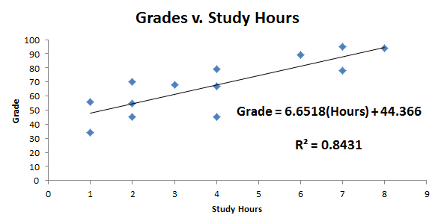
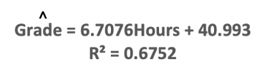
Extrapolation: Example
^
16
Given this data, predict the grade a student who studied 16 hours would receive.
Grade = 6.67076(16 hours) + 40.993 = 150.8 points.
Clearly this is impossible … but we have extrapolated.

Slide 26
Interpretation

Slide 27
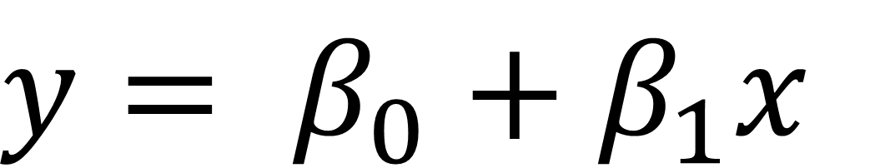
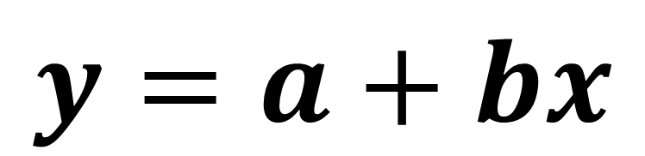
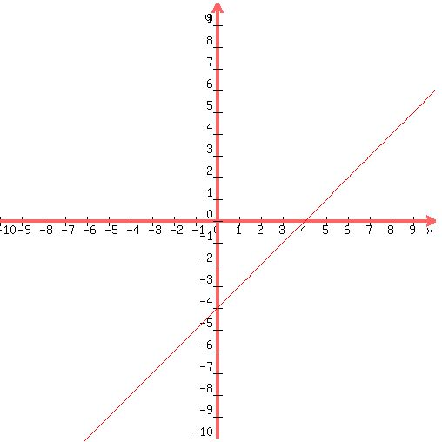
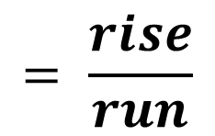
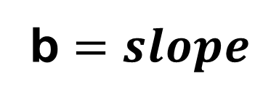
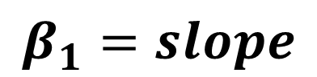
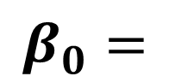
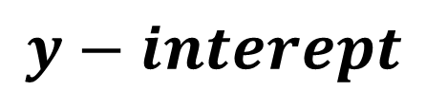
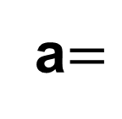
Equation of a Line!
y = mx + b

Slide 28
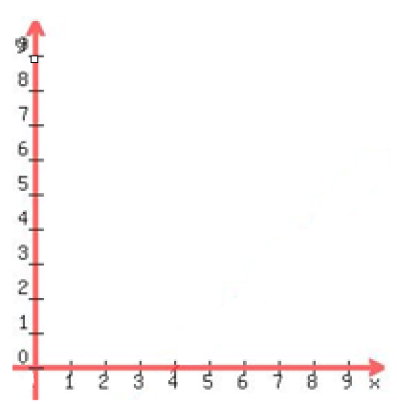




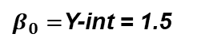
Interpretation: Slope and y-Intercept
$$∆y= 2$$
$$∆x=1$$
$β_{1}=slope=\frac{rise}{run}=\frac{2}{1}$
$$∆y= 2$$
$$∆x=1$$
$β_{0}=$Y-int = 1.5
Slope interpretation: A 1-unit increase in x results in a 2-unit increase in predicted y.
Or, it is estimated that a 1-unit increase in x results in a 2-unit increase in y.
Y-int interpretation: The predicted response that corresponds to x = 0 is 1.5.
Or, it is estimated that when x = 0, y will be 1.5.

Slide 29
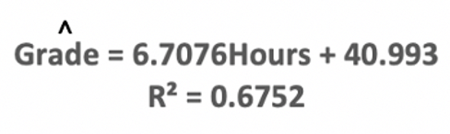
Grades vs. Study Hours
Interpret the slope …
Each extra hour spent studying results in a 6.6707 point increase in the predicted grade.
Interpret the y-intercept …
The predicted grade for a student who studies no hours is 40.993 points.

Slide 31
Estimation of the Intercept and Slope

Slide 32
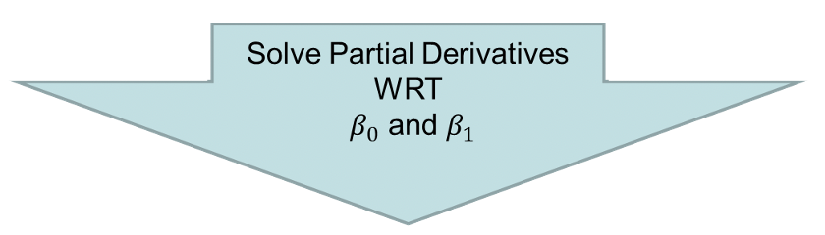
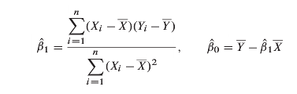
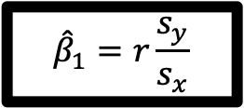

How to Estimate Regression Coefficients
$$SS\left(β_{0},β_{1}\right)=\sum_{i=1}^{n}{{\left[Y_{i}−\left(β_{0}+β_{1}X_{i}\right)\right]}^{2}}$$
$${\hat{β}}_{1}=r\frac{s_{y}}{s_{x}}$$

Slide 33



How to Estimate Regression Coefficients
$${\hat{β}}_{0}=40.993$$
$${\hat{β}}_{1}=6.708$$
$$Grade=40.993+6.708 StudyHours$$

Slide 35
Estimate of the Assumed Common Standard Deviation

Slide 36
Changed to Lightboard

Slide 38
Sampling Distribution of the Sample Intercept and Slope

Slide 39

Sampling Distributions / Hypothesis Test

Slide 40




Sampling Distributions / Hypothesis Test
Two T-Tests!!!

Slide 42
Hypothesis Testing and Confidence Intervals for the Slope and Intercept

Slide 43













CV, TS and Confidence Interval for $β_{0}$ and $β_{1}$
$$H_{0}:β_{0}=0$$
$$H_{0}:β_{1}=0$$
$$H_{A}:β_{0}≠0$$
$$H_{A}:β_{1}≠0$$
$$CV:t_{1−\frac{α}{2}.n−2}$$
$$CV:t_{1−\frac{α}{2}.n−2}$$
TS$:t=\frac{{(\hat{β}}_{0}−β_{0})}{SE\left(β_{0}\right)}$
TS$:t=\frac{{(\hat{β}}_{1}−β_{1})}{SE\left(β_{1}\right)}$
${CI: \hat{β}}_{0}±$ $t_{1−\frac{α}{2}.n−2}SE\left(β_{0}\right)$
${CI: \hat{β}}_{1}±$ $t_{1−\frac{α}{2}.n−2}SE\left(β_{1}\right)$

Slide 45
Putting It All Together
Grades vs. Study Hours

Slide 46
Exam Scores vs. Study Hours
data StudyTime;
input ExamScore StudyTime;
datalines;
34 1
56 1
45 2
70 2
55 2
68 3
67 4
79 4
45 4
89 6
95 7
78 7
94 8
;
proc print data = StudyTime;
run;
StudyTime = data.frame(ExamScore = c(34,56,45,70,55,68,67,79,45,89,95,78,94), StudyHours = c(1,1,2,2,2,3,4,4,4,6,7,7,8))
StudyTime

Slide 47
Exam Scores vs. Study Hours (cont.)
Check the scatter plot to determine if a linear relationship is plausible.
proc sgscatter data = StudyTime;
plot ExamScore*StudyTime;
title "Study Time Analysis";
run;
plot(StudyTime$StudyHours,StudyTime$ExamScore, xlab = "Study Hours", ylab = "Exam Score", main = "Study Time Analysis",pch = 15)

Slide 48


Exam Scores vs. Study Hours: Correlation
$$H0: ρ=0$$
$$Ha: ρ≠0$$
$$\frac{r\sqrt{n −2}}{\sqrt{1 −r^{2}}}\sim t_{n−2}$$
Critical value (use software)
$±t_{.975, 8−2}=±2.$201
Test statistic
There is strong evidence at the alpha = .05 level of significance to suggest that exam scores are linearly related to study hours (p-value = .0006).
$$t=\frac{.8217\sqrt{13 −2}}{\sqrt{1 −{.8217}^{2}}}$$
$$=\frac{.8217\sqrt{11}}{\sqrt{1−.6752}}$$
$=$ 4.7818
p-Value = .0006
Reject H₀ (at level alpha = 0.05)

Slide 49





Exam Scores vs. Study Hours: R
$$H0: β_{1}=0$$
$$Ha:β_{1}≠0$$
fit = lm(ExamScore~StudyHours, data= StudyTime)
summary(fit)
Critical value
$±t_{.975, 8−2}=±2.$201
Test statistic
$$t_{stat} =\frac{{\hat{β}}_{1}−0}{SE({\hat{β}}_{1})}$$
$$=\frac{6.708}{1.403}$$
$=$ 4.782
plot(StudyTime$StudyHours,StudyTime$ExamScore, xlab = "Study Hours", ylab = "Exam Score", main = "Study Time Analysis",pch = 15)
lines(StudyTime$StudyHours, fit$fitted.values)
p-Value = .0006
Reject H₀ (at level alpha = 0.05)
There is strong evidence at the alpha = .05 level of significance to suggest that exam scores are linearly related to study hours (p-value = .0006).

Slide 50

Exam Scores vs. Study Hours: SAS PROC REG
$$H0: β_{1}=0$$
$$Ha:β_{1}≠0$$
Critical value
$±t_{.975, 8−2}=±2.$201
Test statistic
proc glm data = StudyTime;
model ExamScore = StudyTime / solution;
run;
$$t_{stat} =\frac{{\hat{β}}_{1}−0}{SE({\hat{β}}_{1})}$$
$$=\frac{6.708}{1.403}$$
$=$ 4.782
p-Value = .0006
Reject H₀ (at level alpha = 0.05)
There is strong evidence at the alpha = .05 level of significance to suggest that exam scores are linearly related to study hours (p-value = .0006).

Slide 51


Exam Scores vs. Study Hours: SAS PROC GLM
$$H0: β_{1}=0$$
$$Ha:β_{1}≠0$$
Critical value
$±t_{.975, 8−2}=±2.$201
Test statistic
proc glm data = StudyTime;
model ExamScore = StudyTime / solution;
run;
$$t_{stat} =\frac{{\hat{β}}_{1}−0}{SE({\hat{β}}_{1})}$$
$$=\frac{6.708}{1.403}$$
$=$ 4.782
p-Value = .0006
Reject H₀ (at level alpha = 0.05)
There is strong evidence at the alpha = .05 level of significance to suggest that exam scores are linearly related to study hours (p-value = .0006).

Slide 52





Exam Scores vs. Study Hours: Test Statistic
$$H0: ρ=0$$
$$Ha: ρ≠0$$
$$\frac{r\sqrt{n −2}}{\sqrt{1 −r^{2}}}\sim t_{n−2}$$
$$H0: β_{1}=0$$
$$Ha:β_{1}≠0$$
Critical value (use software)
$±t_{.975, 8−2}=±2.$201
Critical value
$±t_{.975, 8−2}=±2.$201
Test statistic
Test statistic
$$t=\frac{.8217\sqrt{13 −2}}{\sqrt{1 −{.8217}^{2}}}$$
$$=\frac{.8217\sqrt{11}}{\sqrt{1−.6752}}$$
$=$ 4.7818
$$t_{stat} =\frac{{\hat{β}}_{1}−0}{SE({\hat{β}}_{1})}$$
$$=\frac{6.708}{1.403}$$
$=$ 4.782
p-Value = .0006
p-Value = .0006
Reject H₀ (at level alpha = 0.05)
Reject H₀ (at level alpha = 0.05)
There is strong evidence at the alpha = .05 level of significance to suggest that exam scores are linearly related to study hours (p-value = .0006).
There is strong evidence at the alpha = .05 level of significance to suggest that exam scores are linearly related to study hours (p-value = .0006).

Slide 53


Exam Scores vs. Study Hours: Confidence Interval
fit = lm(ExamScore~StudyHours, data= StudyTime)
confint(fit, level = .95)
For students who study between 1 and 8 hours total, we are 95% confident that for every additional hour a student studies for the exam, their exam score will increase between 3.6 and 9.8 points.
proc reg data = StudyTime;
model ExamScore = StudyTime / clb;
run;

Slide 55
Appendix

Slide 56
r = .907
r² = 0. 823
^
Points = 6 + 3(Price)
Give it a shot! (No pun intended!)
What is the best predicted maximum points in a game for a player who is paid $9.5 million?
Points = 6 + 3 * 9.5 = 34.5 points predicted in a single game!

Slide 57
r = .907
r² = 0. 823
^
Points = 6 + 3(Price)
Slope interpretation: Each $1 million increase in the price results in a 3-point increase in predicted point production per game.
y-Intercept interpretation: A player who is not paid is still predicted to have 6 points per game on average. Why doesn’t this make sense?
Extrapolation

